Slide 1
MBT SALES OPERATIONS
Field App Quick Guide
For Sales Engineers & BD Team Members
Accounts → MCP (Plan) → Field Contact Reports → Acknowledgment → Approval

Slide 2
HOW IT ALL FITS TOGETHER
Your Workflow at a Glance
1
2
3
4
5
Profile the
Account
Plan the
Month (MCP)
File the
FCR
Attendee
Acknowledges
Approved →
Export PDF
Every Sales Engineer and BD Team member follows the same five steps for each customer visit. The system won't let an FCR export as a PDF until the attendee has acknowledged it and it's been approved.
MBT Sales Operations
2

Slide 3
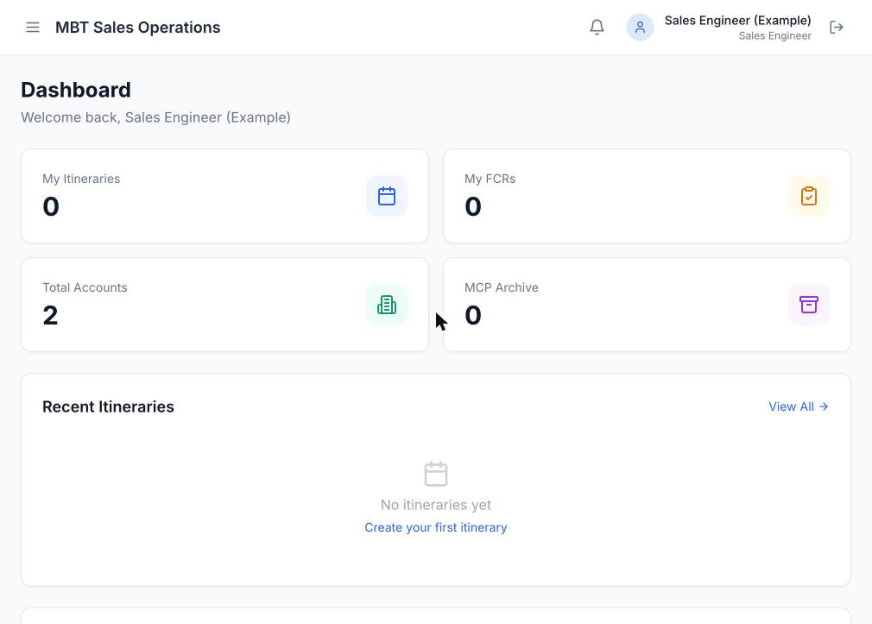
STEP 0 · SIGN IN
Your Dashboard
This is your home screen — everything is scoped to your own accounts, plans, and reports.
Quick Actions let you jump straight into a new Account or a new FCR.
Recent activity and open follow-ups surface here so nothing slips through the cracks.
The sidebar (or menu icon on mobile) is how you get to Accounts, MCP (Plan), FCR, and MCP (Actual).
MBT Sales Operations
3

Slide 4
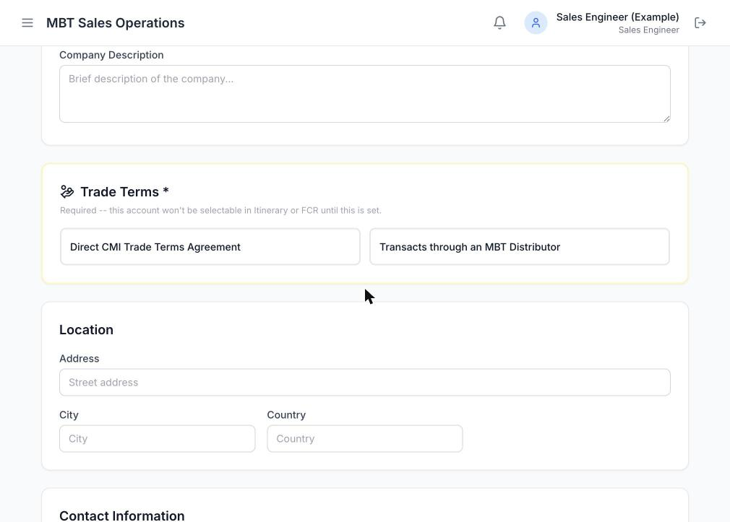
STEP 1 · ACCOUNTS
Profile the Account First
Anyone — SE, BD, or NSM — can add a new Account.
An Account must have its Trade Terms profile completed before it shows up in the FCR account dropdown.
The ASE/TSE field is a dropdown of active Sales Engineers only, used to assign coverage.
Once profiled, an Account's info auto-fills every FCR filed against it — no retyping company details.
MBT Sales Operations
4

Slide 5
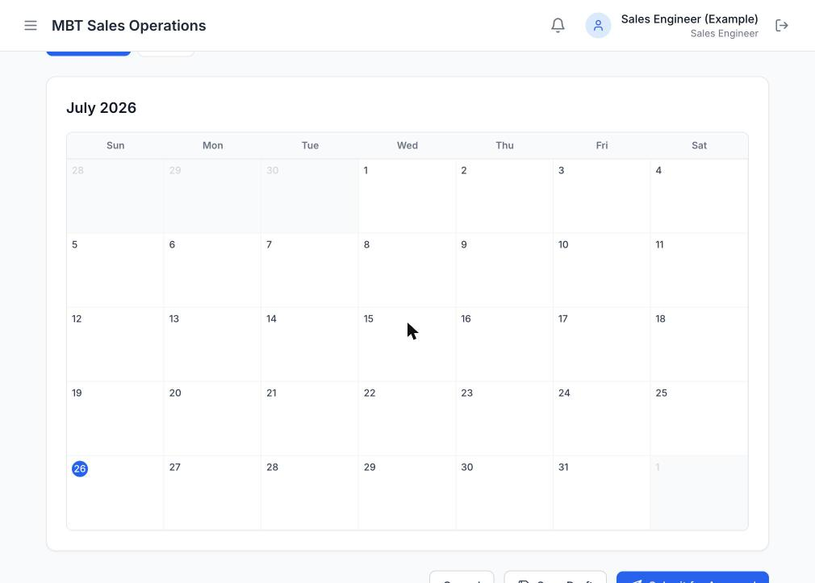
STEP 2 · MCP (PLAN)
Plan Your Monthly Coverage
MCP (Plan) is your proposed visit schedule for the month, laid out on a calendar.
SE plans are approved by the NSM; BD plans are approved by the Commercial AC Head.
Once approved, an itinerary visit can auto-draft its matching FCR for you.
Think of it as the "what I intend to do" — MCP (Actual) later shows "what really happened."
MBT Sales Operations
5

Slide 6
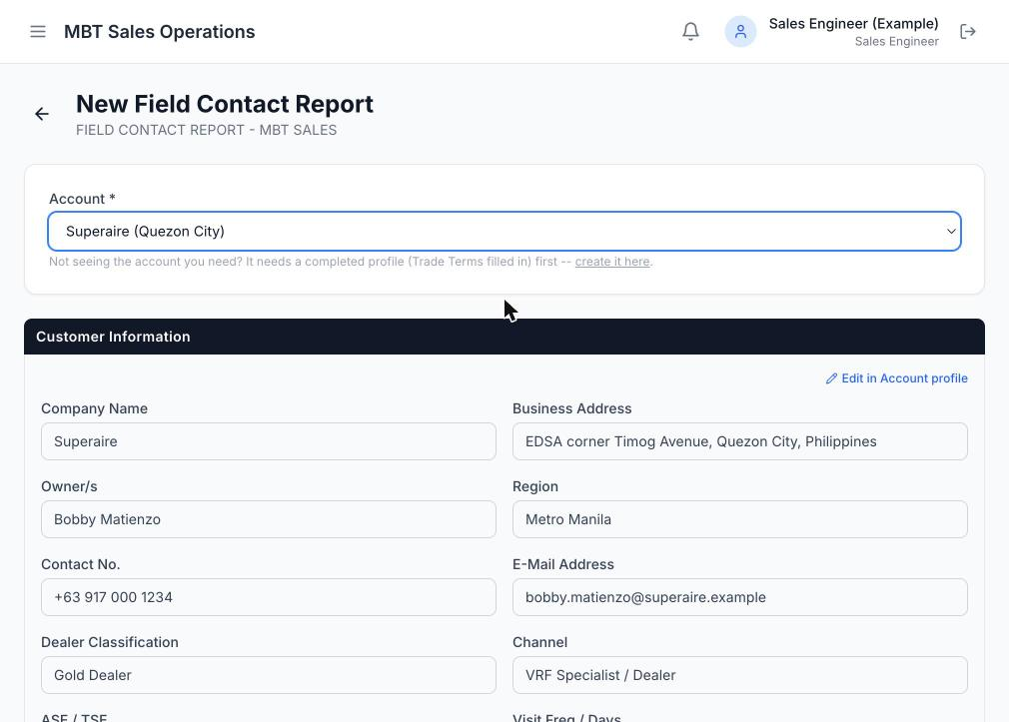
STEP 3 · FIELD CONTACT REPORT
Filing an FCR
Pick a profiled Account — Customer Information auto-fills and is read-only.
Fill in your discussion summary, coverage notes, and any get-back / action items.
SE and BD team members can create FCRs. (The NSM reviews and approves instead of filing their own.)
Linked MBT Project Pipeline projects can be imported straight into Project Opportunities — Bidding-stage projects go to Qualified / Identified; on a BD FCR, Spec-in-flagged projects go to SPEC-IN.
Every field you enter here becomes the Minutes of the Meeting the attendee reviews next.
MBT Sales Operations
6

Slide 7
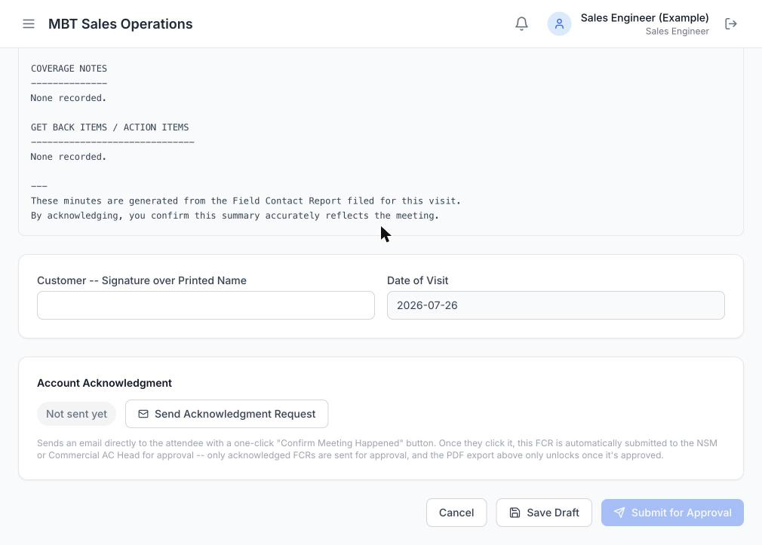
STEP 4 · ACKNOWLEDGMENT
Send for Acknowledgment
Add the attendee's name and email, then click "Send Acknowledgment Request."
The attendee gets an email with the minutes and a one-click confirm button — no login needed.
This step is required: an FCR cannot be exported as a PDF until it's acknowledged and approved.
You can resend the request any time from the same screen if needed.
MBT Sales Operations
7

Slide 8
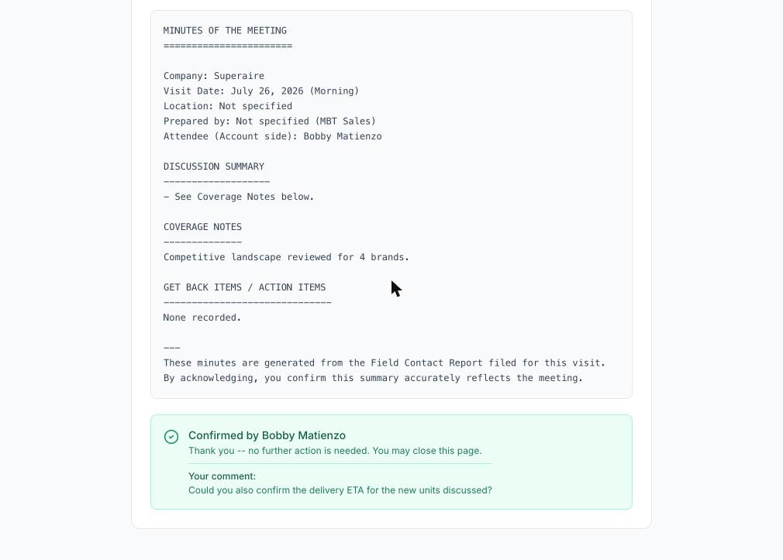
STEP 4 · ACKNOWLEDGMENT
Attendee Confirms → Auto-Submitted
The attendee sees a clean, read-only summary of the visit and an optional comment box — they can add a note or just leave it blank.
The moment they tap "Confirm Meeting Happened," your FCR is automatically submitted for approval — nothing more to do.
SE reports route to the NSM; BD reports route to the Commercial AC Head.
If they left a comment, it shows up on your FCR's Account Acknowledgment card — no separate email or message to check.
MBT Sales Operations
8

Slide 9
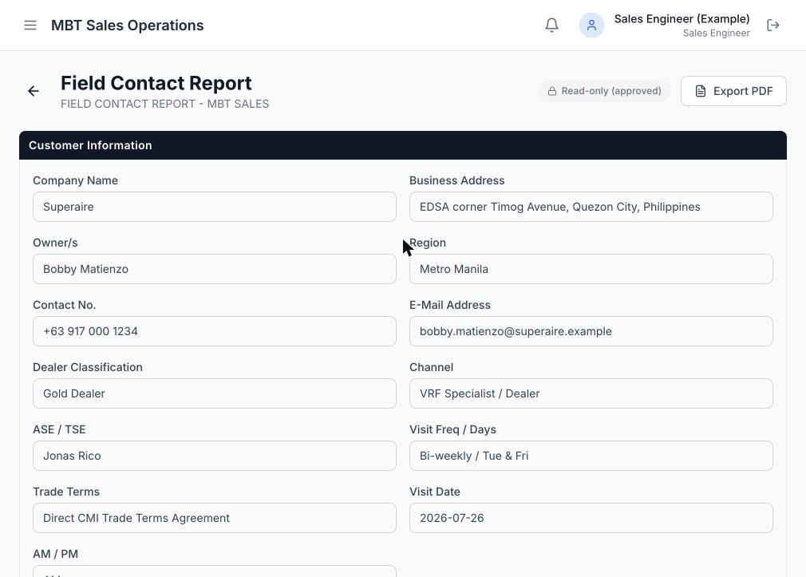
STEP 5 · APPROVAL
Approved → Export as PDF
Once your approver signs off, the FCR becomes read-only and locked in.
The "Export PDF" button — greyed out until now — unlocks automatically.
Your FCR list shows both badges at a glance: Approved, and Minutes Acknowledged.
That PDF is your official, attendee-confirmed record of the visit.
MBT Sales Operations
9

Slide 10
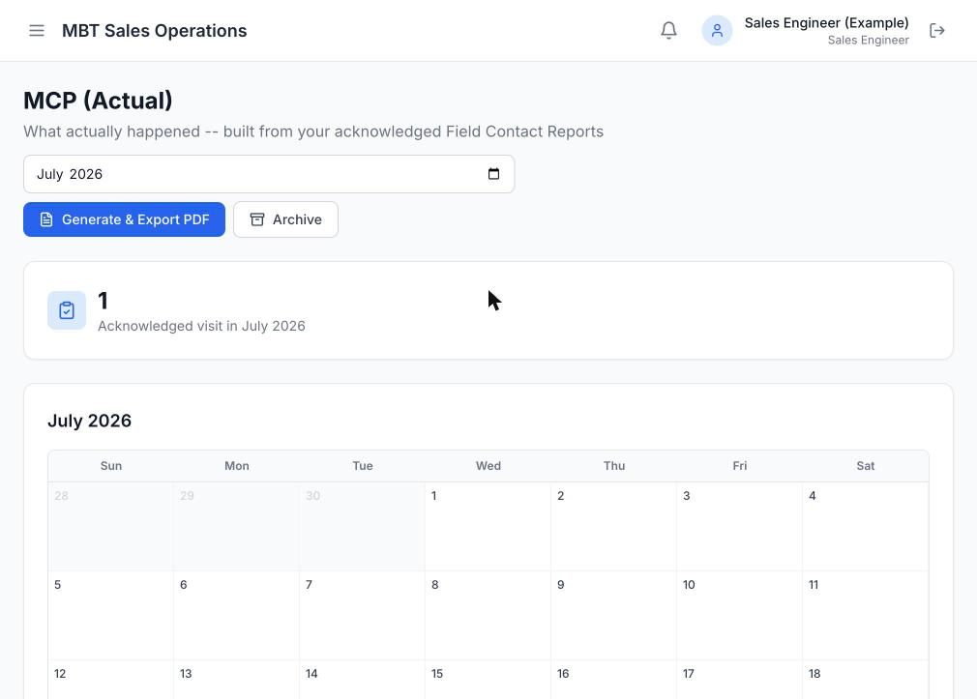
STEP 6 · MCP (ACTUAL)
See What Really Happened
MCP (Actual) is automatically built from your acknowledged FCRs for the month.
It's a calendar view of every visit that's actually been confirmed by an attendee.
Use "Generate & Export PDF" for a shareable monthly summary.
Past months are kept in the Archive for reference.
MBT Sales Operations
10

Slide 11
KEEP THIS HANDY
Quick Reference Cheat Sheet
Action | Sales Engineer | BD Team
Create / profile an Account | Yes | Yes
Create an MCP (Plan) | Yes | Yes
Create an FCR | Yes | Yes
Who approves your MCP (Plan) | NSM | Commercial AC Head
Who approves your FCR | NSM | Commercial AC Head
Export FCR as PDF | After acknowledgment + approval | After acknowledgment + approval
Status badges: Draft · Awaiting Acknowledgment · Minutes Acknowledged · Pending Approval · Approved
MBT Sales Operations
11

Slide 12
QUESTIONS?
We're here to help
MBT SALES ENGINEERS
BD TEAM MEMBERS
Jamaica Linsangan
Ronald Acedillo
Reach out if you notice inconsistencies or have feedback about an SE's visit.
Reach out if you notice inconsistencies or have feedback about a BD visit.
This escalation note also appears automatically in every acknowledgment email sent to your attendees.

